Slide 1
Bucket Sort
EECS 233

Slide 2
Various Sorting Methods Learned
Selection Sort
Insertion Sort
Shell-sort
Bubble Sort
Quick-sort
Merge-sort
Heap-sort

Slide 3
Review: Various Sorting Methods
0 1 2 3 4 5 6 7 8
16
8
13
2
15
9
4
12
24
Selection Sort
  For each position i, where i runs from 0 to length-1, find the element that should be placed there
  Small elements are placed in the beginning of the array
Bubble Sort
  In each pass, swap out-of-order neighboring elements
  Large elements are bubbled up towards the end of the array
Insertion sort
  For every element (starting from the second in the array), insert it into the sorted partial array to the left.
  More efficient if the array is sorted or almost sorted
Shell-sort
  Generalize the Insertion sort to speed-up movement towards the final destination for an element
  Divide into k interleaved subarrays, with increment = k
  For each subarray, run insertion sort
  Repeated this with a decreased value of k until k=1
16 8 13 2 15 9 4 12 24
0 1 2 3 4 5 6 7 8

Slide 4
Review: Quick-Sort
Divide-and-conquer
Choose pivot value to partition an array into two subarrays such that left subarray <= right subarray
  By swapping out-of-place elements
Recursive method to solve the problem
16 8 13 2 15 9 4 12 24
0 1 2 3 4 5 6 7 8
if pivot = 9
0 1 2 3 4 5 6 7 8
4 8 9 2 15 13 16 12 24
All elements <= 9
All elements >= 9

Slide 5
Review: Merge-Sort
Divide-and-conquer
Split an array into halves, forming two subarrays
Recursively apply merge-sort to the subarrays
Merge the sorted subarrays (using a temporary array to contain the sorted array, and copy it back after sorting)
12 15 24 16 11 3 5 21 8 14
12 15 24 16 11 3 5 21 8 14
12 15 24 16 11 3 5 21 8 14
0 1 2 3 4 5 6 7 8 9
0 1 2 3 4 5 6 7 8 9
0 1 2 3 4 5 6 7 8 9

Slide 6
Review: Heap-Sort
Use the heap data structure, which is an array representation of balanced binary search tree (indeed complete binary tree)
buildHeap() to heapify an unsorted array in O(N) time
16 8 13 2 15 9 4 12 24
24 16 13 12 15 9 4 8 2
Extract maximum from the max-at-top heap repeatedly and place the maximum to the end
require O(logN) cost per remove() after buildHeap()
0 1 2 3 4 5 6 7 8
0 1 2 3 4 5 6 7 8

Slide 7
Comparisons
Algorithm | Best-case | Worst-case | Average-case | Extra space
Selection sort | O(n²) | O(n²) | O(n²) | O(1)
Bubble sort | O(n²) | O(n²) | O(n²) | O(1)
Insertion sort | O(n) | O(n²) | O(n²) | O(1)
Shell-sort | O(n*logn) | O(n^{1.5}) | O(n^{1.5}), but can be O(n^{1.25}) | O(1)
Quick-sort | O(n*logn) | O(n²) | O(n*logn) | O(logn) (ave case) O(n) (worst case)
Merge-sort | O(n*logn) | O(n*logn) | O(n*logn) | O(n)
Heap-sort | O(n*logn) | O(n*logn) | O(n*logn) | O(1)

Slide 8
Selection problem revisited
Recall the selection problem: Given a list of N elements and an integer k (1 <= k <= N), find out the k-th largest element in the list.
  We have solutions to utilize heap data structures to achieve reasonable running time of O(N + k*logN)
Can we do better?

Slide 9
Quick-sort for The Selection Problem
We can solve the selection problem more efficiently (at least theoretically, needs only linear time O(N))
  Pick a pivot value
  Divide: partition the array into left and right subarrays
  Conquer:
    If (k < right.length), find the k-th largest in right recursively
    If (k > right.length), find the (k-right.length)-th largest in left recursively
  Either way, we make only one recursive call

Slide 10
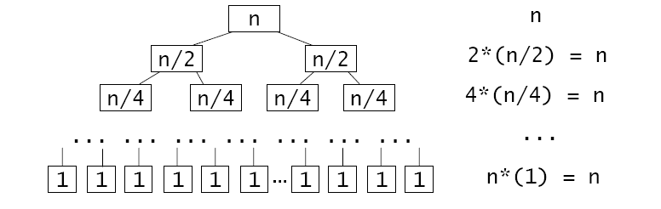

Example
Find the 5th largest value in
Find the 2nd largest value in left subarray only
Find the 2nd largest value in right subarray only
….
n
0 1 2 3 4 5 6 7 8
16 8 12 2 15 9 4 13 24
n/2
n/4
pivot=15
…
0 1 2 3 4 5 6 7 8
1
13 8 12 2 4 9 15 16 24
2n-1
pivot=12
9 8 4 2 12 13
  Best- and average-case linear time complexity!
  But poor worst-case complexity

Slide 11
Bucket Sort
Bucket sort
  Assumption: integer keys in the range [0, M)
  Basic idea:
    1. Create M linked lists (buckets), one for each possible key value
    2. Add each input element to appropriate bucket
    3. Concatenate the buckets
Remember hash tables also uses buckets?

Slide 12
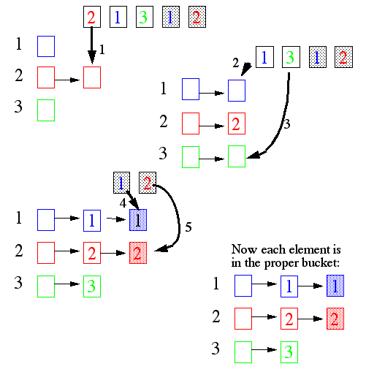
Bucket Sort Example

Slide 13
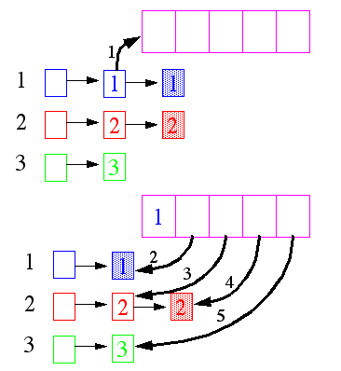

Bucket Sort Example
Pull the elements from the buckets into the array
Expected total time is O(M+N), with N = size of original array, M = number of buckets
Remember hash tables also uses buckets?
  Bucket sort preserves order (key values) in buckets
  Hashing mixes up elements with diverse key values

Slide 14
Keys of Non-integer Types?
What if keys are not integers?
  Assumption: input is N floating numbers (scaled) in [0, 1]
  Basic idea:
    Create M linked lists (buckets) to divide interval [0,1] into subintervals of size 1/M
    Add each input element to appropriate bucket and sort the bucket with insertion sort
  Choose M=O(N)
  Uniform input distribution → expected bucket size is O(1)
    Therefore the expected total time is O(N): O(N) to put elements into the buckets and O(N) to move them back into the array
With uniform key distribution, Bucket Sort has O(N) running time
But sensitive to the key distribution in the range (what if it’s not uniform?)
Pays with space for time
Pays with worst-case time for average-case time

Slide 15
External Sorting
Question: how to sort 10TB of data with 10GB of RAM.
Elements will be swapped in and out of RAM – expensive!
Objectives
  Primary: reduce the cost due to disk I/Os
  Secondary: CPU processing time

Slide 16
Two-Way External Merge-Sort: The Idea
Pass 0: Read a page, sort it, and write it back to the disk.
  only one buffer page is used
  can use any internal sorting method
Pass 1, 2, …, etc.:
  requires 3 buffers
  merge pairs of runs into runs twice as long
INPUT 1
…
OUTPUT
INPUT 2
Main memory buffers
Disk
Disk

Slide 17
Two-Way External Merge-Sort
N pages in the file
In each pass we read and write each page in file.
  2N page I/O operations
The number of passes
=⎡ log₂ N ⎤+1
So total cost, in number of page I/Os, is:
2N(⎡ log₂ N ⎤+1)
3,4
6,2
9,4
8,7
5,6
3,1
2
Input file
PASS 0
3,4
2,6
4,9
7,8
5,6
1,3
2
PASS 1
2,3
4,7
1,3
4,6
8,9
5,6
2
PASS 2
2,3
4,4
1
6,7
2,3
8,9
5,6
PASS 3
1,2
2,3
3,4
4,5
6,6
7,8
9

Slide 18
Multi-Way External Merge-Sort
We have more than 3 buffer pages, allowing multi-way merge
To sort a file with N pages using B buffer pages:
  Pass 0: Use 1 buffer. Read every page, sort, write back.
  Pass 1: Use (B-1) input buffers and 1 output buffer.
  Merge every bunch of B-1 pages into a sorted run of (B-1) pages each.
  Pass 2: merge every bunch of B-1 runs into a sorted run of (B-1)² pages each
  Pass 3: merge every bunch of B-1 runs into a sorted run of (B-1)³ pages each
  …
INPUT 1
. . .
INPUT 2
. . .
. . .
OUTPUT
INPUT B-1
Disk
Disk
B Main memory buffers

Slide 19
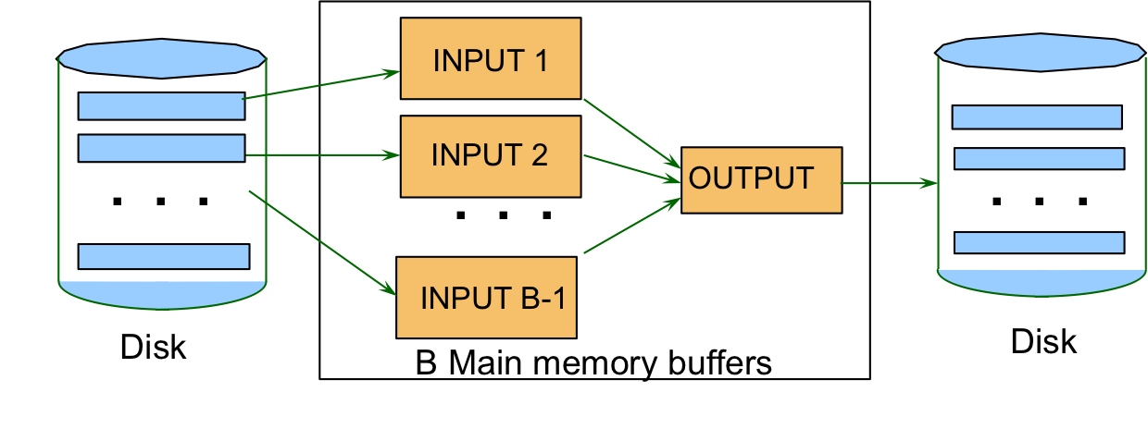
Multi-Way External Merge-Sort: Cost
Number of passes: 1+⎡log_{B-1}N⎤
  With B=257, 4 passes to sort 1B-page file (4TB)
Cost (in number of page I/Os):
  2N*(number of passes)
Example: with B=5 buffer pages, to sort 108 page file:
  Pass 0: 216 page I/Os to prepare sorted pages
  Then do four-way merges:
  Pass 1: produce ⎡108/4⎤ = 27 sorted runs of 4 pages each
  Pass 2: produce ⎡27/4⎤ = 7 sorted runs of 16 pages each (last run is only 12 pages)
  Pass 3: produce ⎡7/4⎤ = 2 sorted runs, 64 pages and 44 pages
  Pass 4: Merge the two runs into sorted file of 108 pages

